Slide 1
UE19CS390A – Project Phase – 1
End Semester Assessment
Project Title : Twitter Sentiment analysis for Bitcoin Price
Prediction
Project ID : 55
Project Guide : Prof Prajwala
Project Team : Achyut Jagini
Vedanth Mohan
Kaushal Mahajan
Namita Aluvathingal

Slide 2
Outline
Abstract
Summary of Literature Survey
Suggestions from Review – 3
Design details
Architecture
Technologies Used
Project Progress
References

Slide 3
Abstract
Sentiment Analysis is a sub-research area of computational Natural Language Processing.
Sentiment analysis is used to determine positive, negative, and neutral opinions of a text.
Twitter tweets are very different compared to other forms of text, with highly irregular grammar, high emoticon use and sarcasm.
Common out-of-box sentiment analysis are challenged to produce good results on tweets.

Slide 4
Summary of Literature Survey
title | author | models used | metrics
Twitter Sentiment Analysis for Bitcoin Price Prediction | Sara Abdali,Ben Hoskins 2021 | Naive Bayes and SVM BERT | training accuracy of 78% and a peak accuracy of 63% on the test set when C = 0.01.
Recurrent Neural Network Based Bitcoin Price Prediction by Twitter Sentiment Analysis | D. R. Pant, P. Neupane, A. Poudel, A. K. Pokhrel and B. K. Lama - 2018 | Text classification: Word2Vector and Bag-of-Words Sentiment analysis: Naïve Bayes , Bernouli Naïve Bayes, Multinomial Naïve Bayes, Linear Support Vector Classifier and Random Forest | Word2Vector accuracy is 69.82% whereas Bag-of-words accuracy is 78.49%. The accuracy for sentiment classification of tweets is 81.39 % and the price prediction accuracy using RNN is 77.62%.

Slide 5
Summary of Literature Survey
title | author | models used | metrics
Forecasting Bitcoin Price Fluctuation by Twitter Sentiment Analysis | Otabek Sattarov,Heung Seok Jeon,Ryumduck Oh,Jun Dong Lee-2020 | VADER, Random Forest Regression | 62.48%avg acc. 37.52 avg acc error with the extremes being 43.83% and 21.84% .
Cryptocurrency Price Prediction using Sentiment Analysis | Abdul Rehman Khurshid -2021 | VADER Linear support vector classification, multinomial Naive Bayes, and Bernoulli Naive Bayes(classify news and social media sentiment) neural networks (NN), support vector machines (SVM) and random forest (RF) for selected few cryptos aggregated Twitter sentiment change over time periods ranging between 5 minutes and 4 hours LSTM ,historical cryptocurrency prices and data from Sina-Weibo | Logistic regression produced the best results. LSTM 87 percent accuracy rate aggregated method gave 83 %

Slide 6
Summary of Literature Survey
title | author | models used | metrics
Cryptocurrency Price Prediction Using Tweet Volumes and Sentiment Analysis | Jethin Abraham, Daniel Higdon, Jack Nelson, Juan Ibarra -2018 | VADER ”Pearson R” and the p-value(between google trend price and tweet volume) | The Pearson R of the correlation is 0.817 at p-value of 0. The correlation held during periods of increasing and decreasing prices suggest that the relationship is robust to periods of high variance and non-linearity.

Slide 7
Suggestions from Review – 3
Architecture modification
Consider other factors that could impact price prediction
Consider visualization of data/ graphical representation and creating an app

Slide 8
Design Details
Performance - Runs well on 64 bit PC’s with minimum 4GB RAM
Portability - User interface is google colab, it is easily portable
Compatibility - Compatible with Windows, Linux and macOS

Slide 9
We check the tweeter’s status to determine the extent of influence their tweets have.
To do this, we check the verified profile information for each tweet we use.

Slide 10
Datasets
Tweets-https://www.kaggle.com/datasets/kaushiksuresh147/bitcoin-tweets
Dataset has 13 columns.
No | Columns | Descriptions
1 | user_name | The name of the user, as they’ve defined it.
2 | user_location | The user-defined location for this account’s profile.
3 | user_description | The user-defined UTF-8 string describing their account.
4 | user_created | Time and date, when the account was created.
5 | user_followers | The number of followers an account currently has.
6 | user_friends | The number of friends an account currently has.
7 | user_favourites | The number of favorites an account currently has
8 | user_verified | When true, indicates that the user has a verified account
9 | date | UTC time and date when the Tweet was created
10 | text | The actual UTF-8 text of the Tweet
11 | hashtags | All the other hashtags posted in the tweet along with #Bitcoin & #btc
12 | source | Utility used to post the Tweet, Tweets from the Twitter website have a source value - web
13 | is_retweet | Indicates whether this Tweet has been Retweeted by the authenticating user.
No | Columns | Descriptions
1 | user_name | The name of the user, as they’ve defined it.
2 | user_location | The user-defined location for this account’s profile.
3 | user_description | The user-defined UTF-8 string describing their account.
4 | user_created | Time and date, when the account was created.
5 | user_followers | The number of followers an account currently has.
6 | user_friends | The number of friends an account currently has.
7 | user_favourites | The number of favorites an account currently has
8 | user_verified | When true, indicates that the user has a verified account
9 | date | UTC time and date when the Tweet was created
10 | text | The actual UTF-8 text of the Tweet
11 | hashtags | All the other hashtags posted in the tweet along with #Bitcoin & #btc
12 | source | Utility used to post the Tweet, Tweets from the Twitter website have a source value - web
13 | is_retweet | Indicates whether this Tweet has been Retweeted by the authenticating user.

Slide 11
Datasets
Bitcoin historical data
https://in.investing.com/crypto/bitcoin/historical-data
Has columns Date,Price,Open,High,Low,Volume.

Slide 12
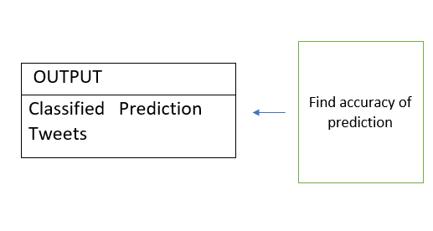
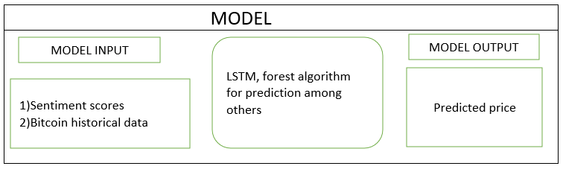
Architecture
PREPROCESSING
1.Convert tweets to lower case 2.Remove URL’s, excess white spaces, mentions 3.Replace 2 or more spaces with single space 4.Checking verification status
INPUT
Tweets
Sentiment analysis
VADER used to find sentiment of tweets

Slide 13
Architecture
1. Collecting Tweets, Bitcoin historical data
Tweets collected have #Bitcoin, #btc hashtags.
Tweets collected were posted almost every minute
2. Preprocess tweets
Techniques used:
Convert the tweet to the lower case.
Remove URLs, excess (white) space and mentions
Strip spaces and quotes (" and ’) from the ends of tweet.
Replace 2 or more spaces with a single space.
Reducing user mentioned places.
Turning hashtags to the typical words.

Slide 14
Architecture
3. Sentiment Analysis
VADER (Valence Aware Dictionary for sentiment Reasoning) sentiment. VADER analysis provides several benefits including the fact that it not only classifies text as positive, negative, or neutral (polarity) but also measures the intensity of words used.
The sentiment analysis method of VADER is well suited to the sentiment of
social media. The sentiment feature of VADER returns a polarity score for a compound.
The polarity score for VADER is between -1 and 1,where from -1 to 0 is negative, 0 is neutral and 0 to 1 is positive.
4.
Use sentiment analyzing score and history price of Bitcoin as an input data and implement a random forest algorithm .
LSTM,Random Forest effective with working with different kind of inputs that has no relationships with each other. The algorithm has advantages in predicting future
outputs as well.

Slide 15
Architecture
5.Compare prediction model’s output data with actual Bitcoin price movements.
6. Find the accuracy of the prediction by checking the model’s outputs and make calculations evaluating the model’s performance.

Slide 16
Technologies Used
User Interfaces
Google colab
2. Hardware Requirements
Processor: 64-bit
RAM: 4GB
3. Software Requirements
Google colab
Twitter API
Python 3.7
Libraries:Selenium,Scikitlearn, Pandas, NumPy, Matplotlib and a few ML model libraries.
Data on the prices of bitcoin for a certain time range. Source: Kaggle, Google
Tweets related to bitcoin during the same time range. Source: Twitter

Slide 17
Project Progress
Project progress so far:
Literature survey
Identified architecture

Slide 18
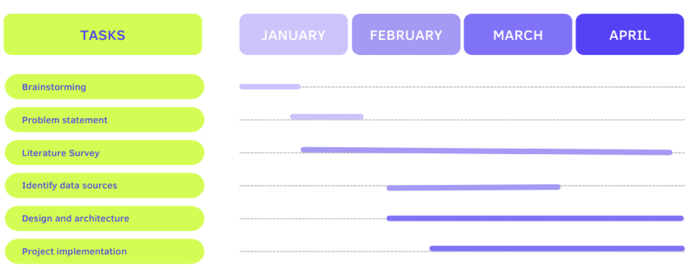
Capstone Phase-I Project Timeline

Slide 19
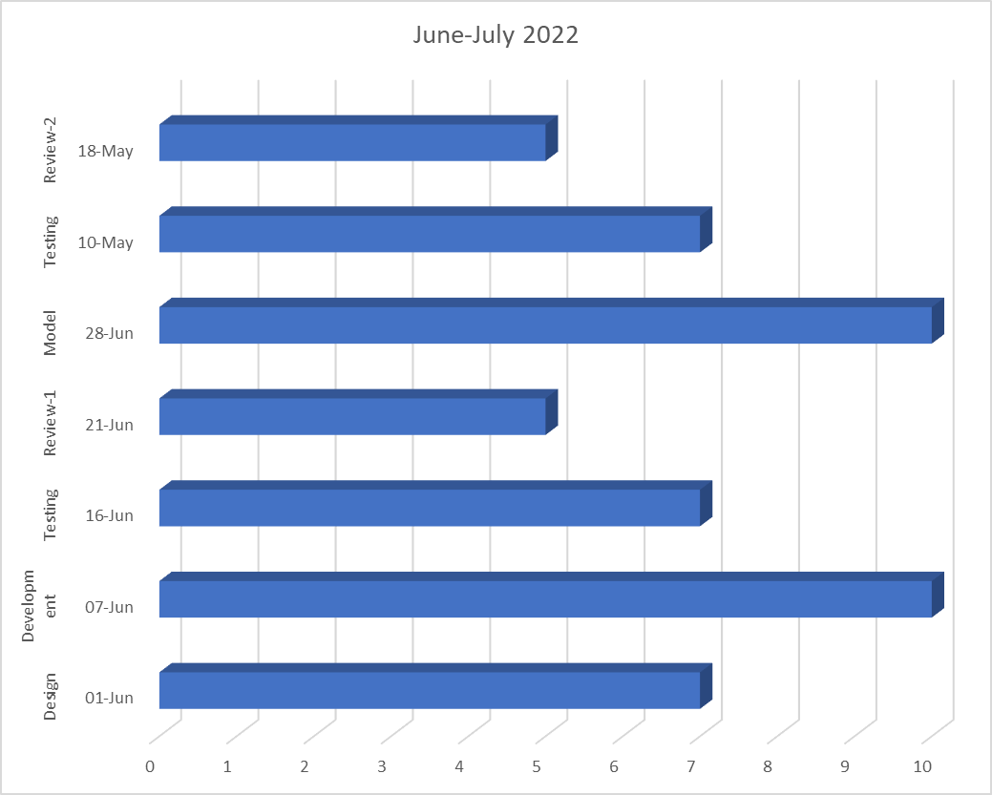
Capstone Phase-2 Project Timeline

Slide 20
Conclusion
By reading more about our project and the papers published on it, we further understood the various models we can use, their advantages and limitations, gained better insight into the scope of the project, and validated our hypothesis.
The architecture to be used was identified.

Slide 21
References
E. Şaşmaz and F. B. Tek, "Tweet Sentiment Analysis for Cryptocurrencies," 2021 6th International Conference on Computer Science and Engineering (UBMK), 2021, pp. 613-618, doi: 10.1109/UBMK52708.2021.955891
Twitter Sentiment Analysis for Bitcoin Price Prediction - Sara Abdali Ben Hoskins 2021
D. R. Pant, P. Neupane, A. Poudel, A. K. Pokhrel and B. K. Lama, "Recurrent Neural Network Based Bitcoin Price Prediction by Twitter Sentiment Analysis," 2018 IEEE 3rd International Conference on Computing, Communication and Security (ICCCS), 2018, pp. 128-132, doi: 10.1109/CCCS.2018.8586824.

Slide 22
References
O. Sattarov, H. S. Jeon, R. Oh and J. D. Lee, "Forecasting Bitcoin Price Fluctuation by Twitter Sentiment Analysis," 2020 International Conference on Information Science and Communications Technologies (ICISCT), 2020, pp. 1-4, doi: 10.1109/ICISCT50599.2020.9351527.
Abraham, Jethin; Higdon, Daniel; Nelson, John; and Ibarra, Juan (2018) "Cryptocurrency Price Prediction Using Tweet Volumes and
Sentiment Analysis," SMU Data Science Review: Vol. 1 : No. 3 , Article 1

Slide 23
Thank You

